Slide 1
Automation Testing
ZL Chen, SIoT DQA, Advantech

Slide 2
Agenda
Automation Testing
Automation Testing Tools
Continuous Integration

Slide 3
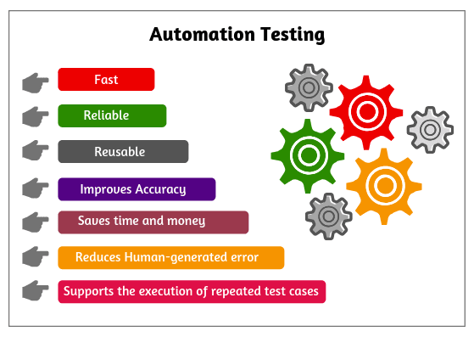
Notes:
自動化測試就像利用自動化執行手動測試的行為，像是自動化的回歸測試。

Slide 4

Automation Testing Tools
Roaming Automation
Airplane ON/OFF Mode Automation
Wi-Fi Frequency Switch Automation
Luminance Automation
Resolution Automation
PXE Automatic Installation
ProgramIndex Automation

Slide 5
Roaming Automation
Improvement
Reduce the manual testing errors.
In order to switch the AP process.
Accurately to capture the ping logs.
Execute the long-term load testing.
Finished the ten times by roaming
Digital Attenuator
Notes:
解決方案
減少手動測試失誤問題
省去手動切換 AP 行為
準確擷取 Ping 紀錄檔
長時間壓力測試執行

Slide 6
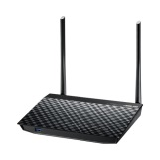
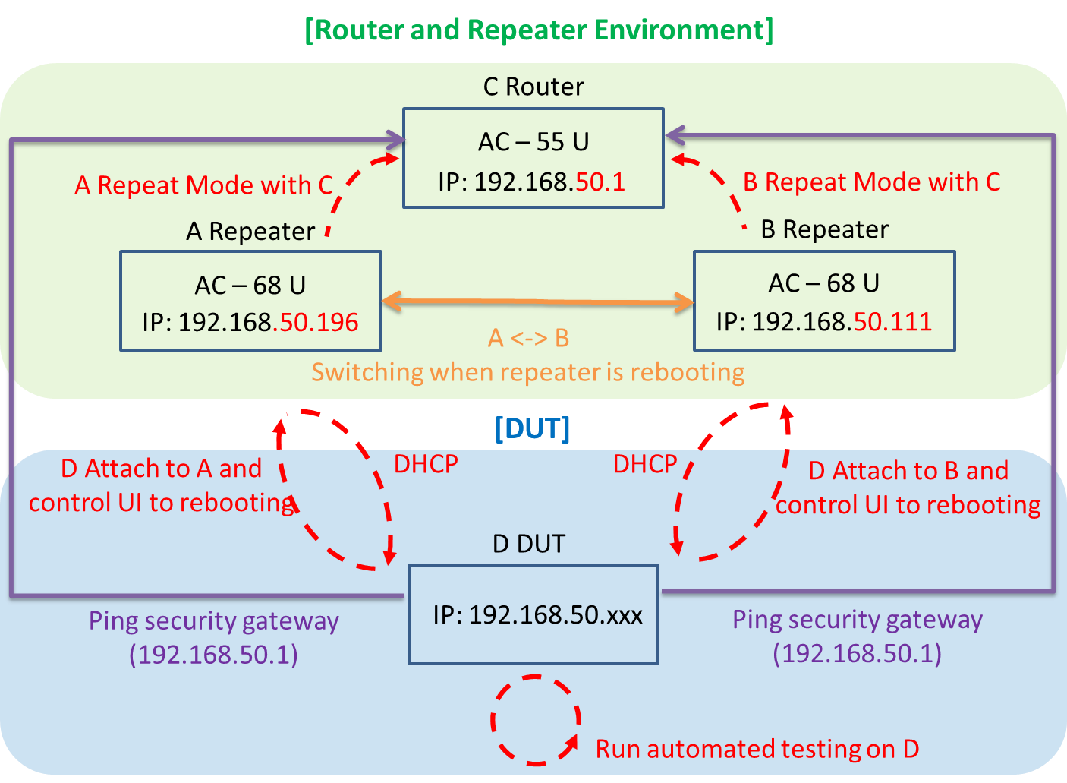
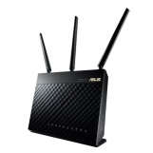
Roaming Automation
System Structure

Slide 7
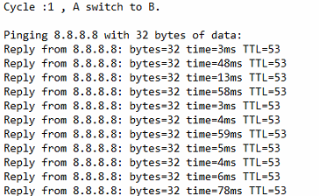
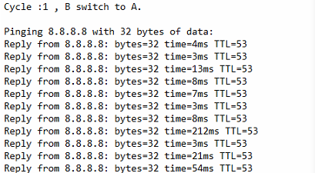
Roaming Automation
The roaming’s ping log are as below:

Slide 8
Wi-Fi Frequency Switch Automation
Improvement
In order to fine-tune the switch function of the [N Only] and [Legacy] based on Wi-Fi AP switch of 2.4G.
In order to fine-tune the switch function of the [N/AC mixed] and [Legacy] based on Wi-Fi AP switch of 5G.
Load testing of 2.4G and 5G.
Notes:
解決方案
針對 Wi-Fi Mode 中的 2.4 G 中的 N Only, Legacy 相互切換
針對 Wi-Fi Mode 中的 5 G 中的 N/AC mixed, Legacy 相互切換
長時間做 2.4 G 及 5 G 之壓力測試

Slide 9
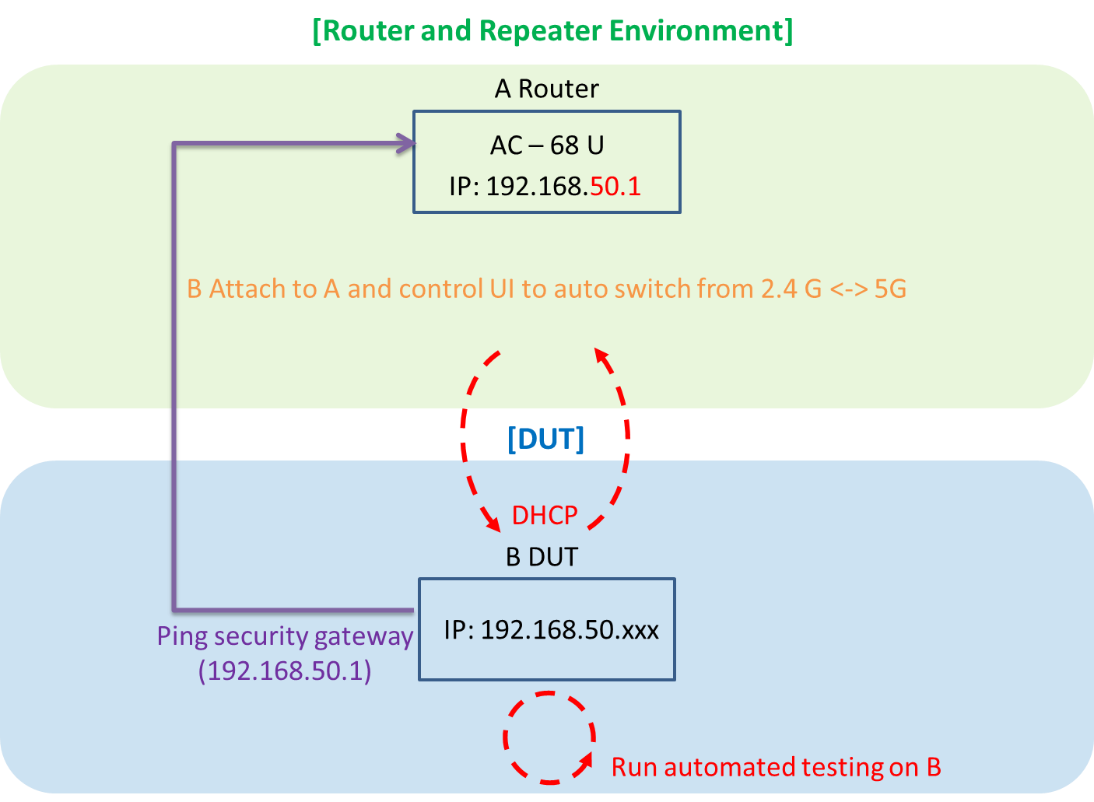
Wi-Fi frequency switch automation
System Structure

Slide 10
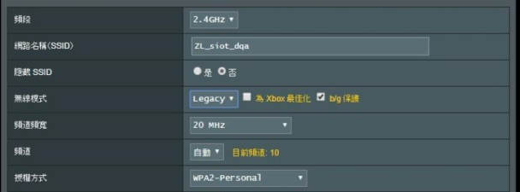
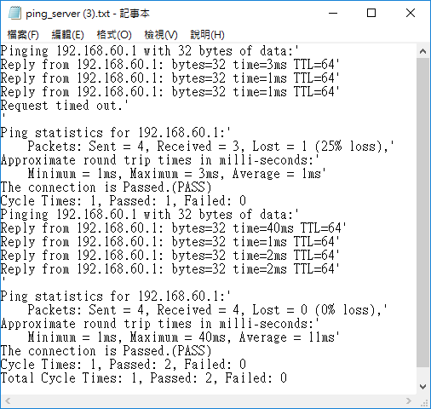
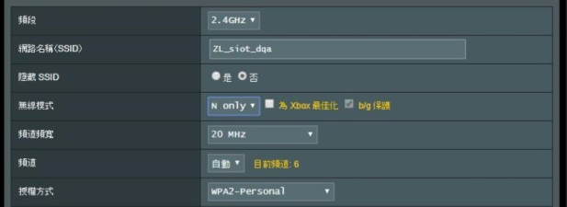
Wi-Fi frequency switch automation
The Wi-Fi switch’s screenshot and log are as below:

Slide 11
Airplane ON/OFF Mode Automation
Improvement
Finish the airplane switch on/off mode stability by load testing.
Notes:
解決方案
長時間壓力下且能完成飛航模式開關的穩定性
大致區分為以下五種：
透過 RJ-45 做 Android 6.0 系統中的 WLAN 或 WWAN 壓力測試
透過 RJ-45 做 Android 8.0 系統中的 WLAN 或 WWAN 壓力測試
透過 OTG 做 Android 6.0 系統中的 WLAN 或 WWAN 壓力測試
透過 OTG 做 Android 8.0 系統中的 WLAN 或 WWAN 壓力測試
Windows 系統中的 WLAN 壓力測試

Slide 12
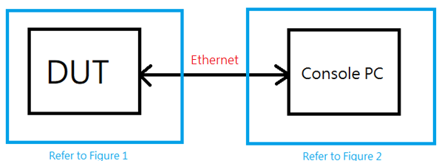
Airplane ON/OFF Mode Automation(Androd, RJ45)
Android 6.0.1 or 8.0.1 for WLAN and WWAN
Block Diagram

Slide 13
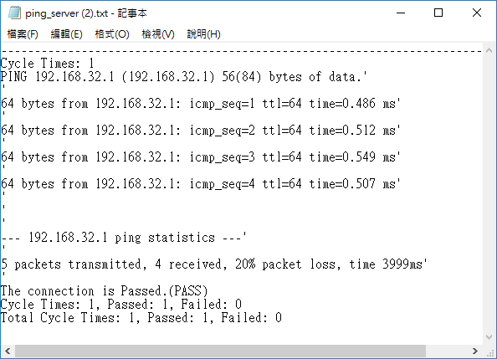
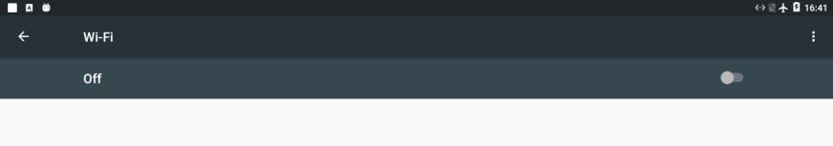
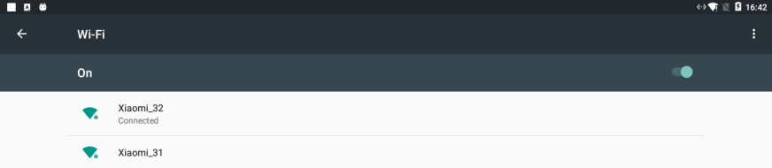
Airplane ON/OFF Mode Automation(Androd, RJ45)
The output screenshot and log are as below.
Airplane ON (Wi-Fi OFF)
Airplane ON (Wi-Fi OFF)

Slide 14
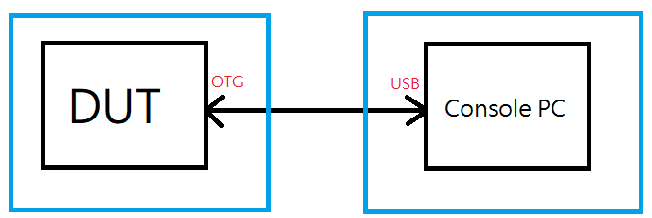
Airplane ON/OFF Mode Automation(Android, OTG)
Android 6.0.1 or 8.0.1 for WLAN and WWAN
Block Diagram

Slide 15
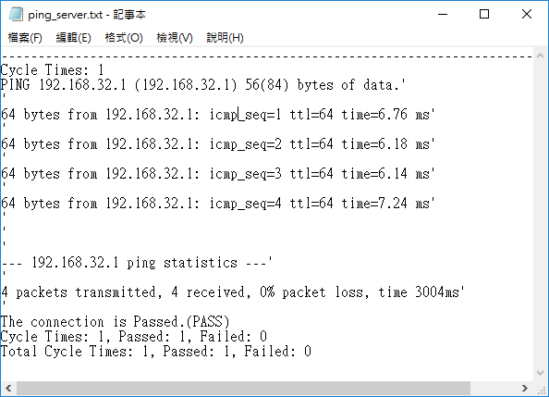
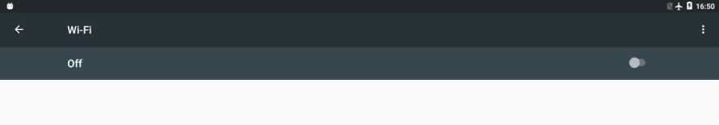
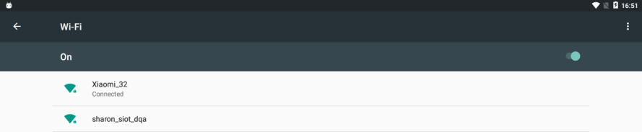
Airplane ON/OFF Mode Automation(Android, OTG)
The output screenshot and log are as below.
Airplane ON (Wi-Fi OFF)
Airplane ON (Wi-Fi OFF)

Slide 16


Airplane ON/OFF Mode Automation(Windows)
Windows for WLAN
The test script base on Sikuli API under the windows environment.
Airplane ON/OFF Mode Automation

Slide 17
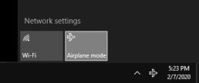
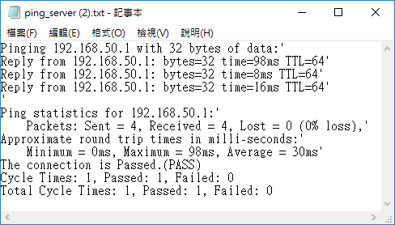
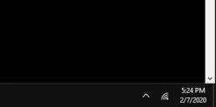
Airplane ON/OFF Mode Automation(Windows)
The output screenshot and log as below.
Airplane ON (Wi-Fi OFF)
Airplane ON (Wi-Fi OFF)

Slide 18
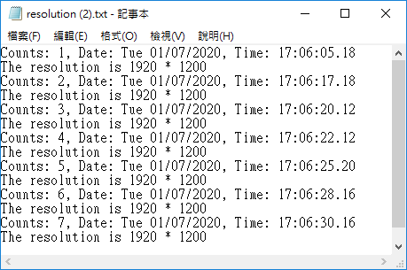
Resolution Automation
Improvement
Automatically capture the GPU resolution of the host/mainframe with auto testing process.
Reboot with long period to capture resolution.
The Tool base on the GPU resolution
Auto catch the resolution by batch code
Auto catch the resolution by batch code.
(Reboot)
Notes:
解決方案
透過程式自動擷取主機 GPU 解析度
長時間重開機解析度擷取

Slide 19
Luminance automation
Improvement
Develop a production program according to the product requirements and spec.
Fast generate picture and write program to measure the panel.
Notes:
解決方案
依產品需求規格製作產圖之程式
方便內部人員快速產圖並做量測 Panel 之程式

Slide 20
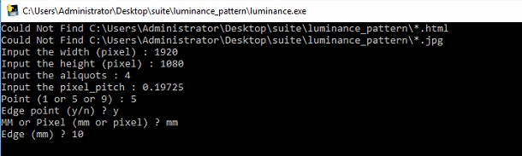
Luminance automation
The tool of pre-conditions base on the product specification.

Slide 21

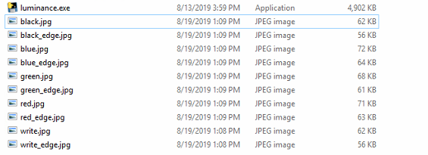
Luminance automation
The output luminance photo.

Slide 22
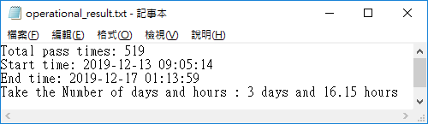
PXE automatic installation
Improvement
Automatic process/procedure installing the Windows OS.
Load testing of long-term automatically install.
Operation system installation. (UEFI 32 bits, UEFI 32 bits, Legacy 32bits)
Notes:
解決方案
自動化安裝 Windows OS 程序
長時間自動安裝壓力測試

Slide 23
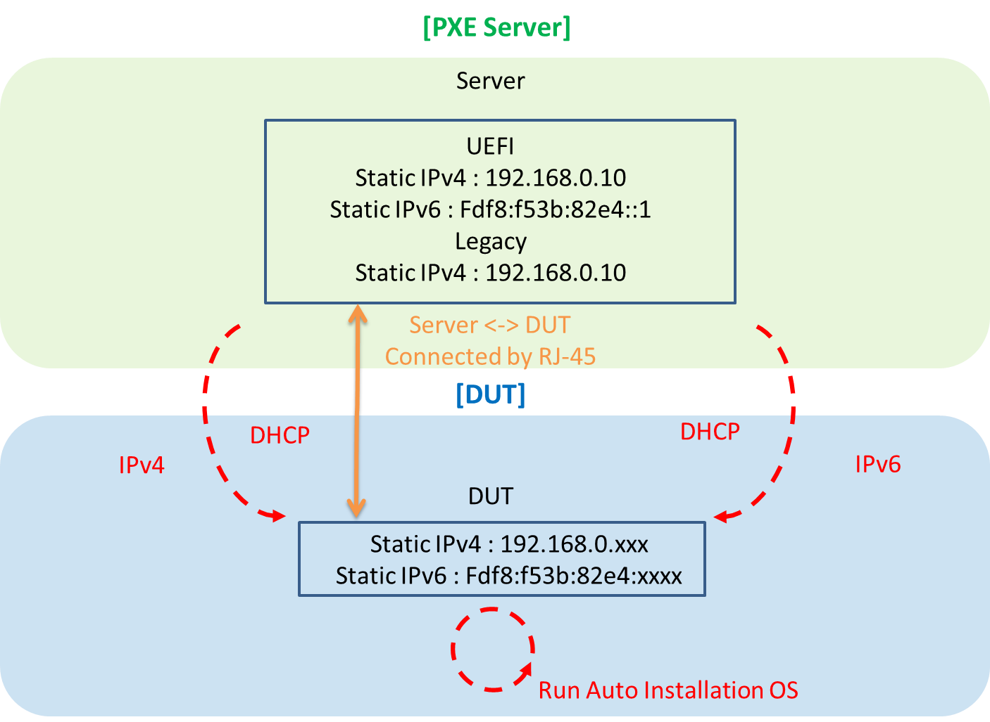
PXE automatic installation
System Structure

Slide 24
ProgramIndex automation
Improvement
Download corresponding programs using ProgramIndex.
Extract data/files on FTP Server and download right away.
Notes:
解決方案
透過 ProgramIndex 程式方便下載相對應程式
可以直接抓取 FTP 上的資料直接下載

Slide 25
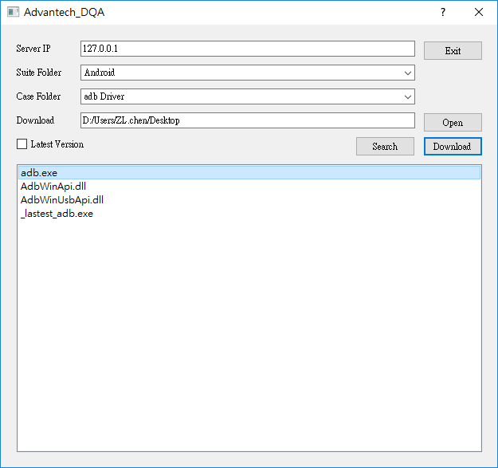
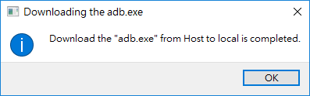
ProgramIndex automation
Download the file by ProgramIndex user interface.
Server IP
Suite Folder
Case Folder
Downlod

Slide 26
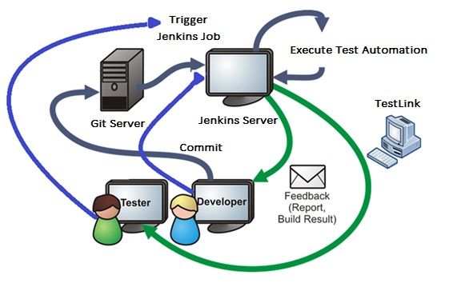
Continuous Integration

Slide 27
Go Together,
We Go Far and Grow Big

